Slide 1

Exploring Generative AI: A Dive into Practical and Creative Applications
Sumit Ghosh
Puspita Chowdhury
Pranav Kumar
Manaswini Pedimalla

Slide 2
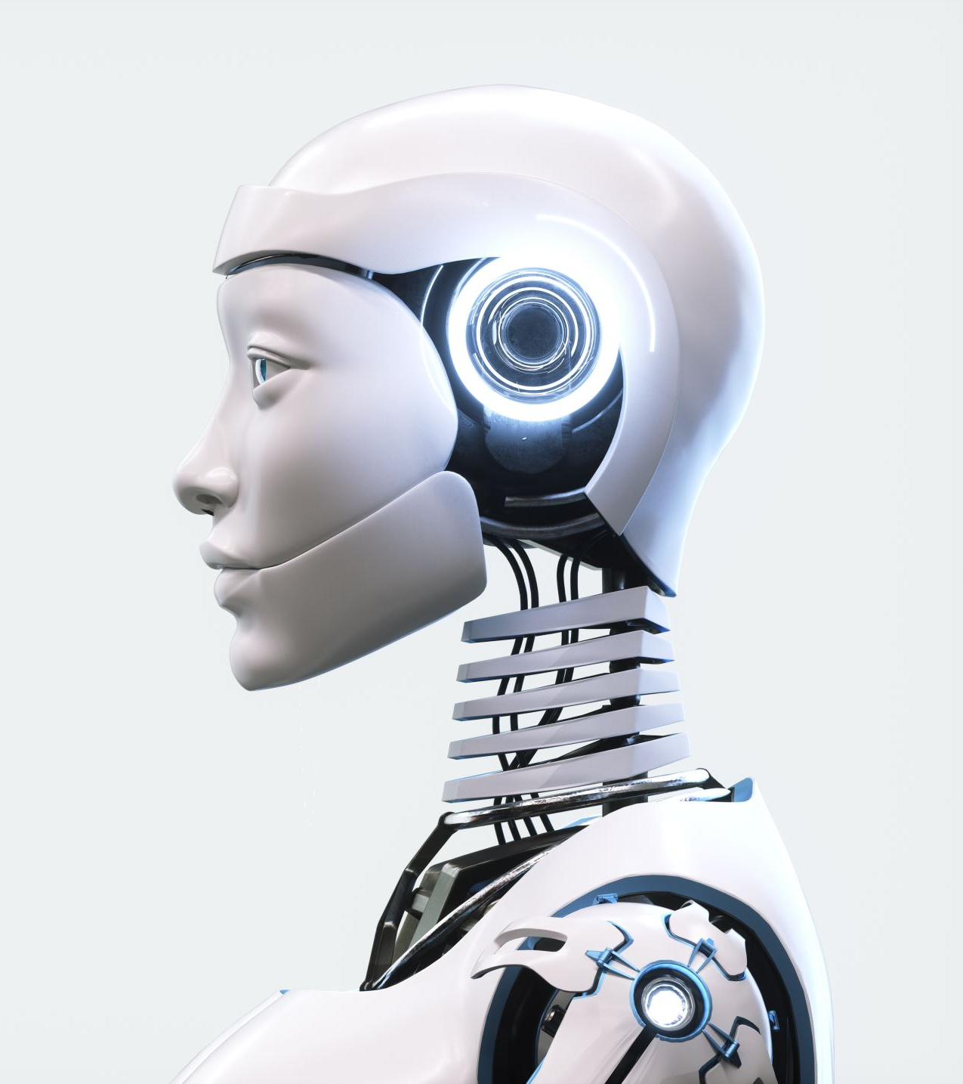
Introduction
Artificial intelligence is impacting the way in which enterprises engage with consumers
This project explores how Artificial Intelligence, especially Large Language Models (LLMs), is being used in real-world applications.
Focus on practical and creative use cases: image generation, mental health support, personalized assistants, and text summarization.
Aim of the project : To understand how these technologies work and where they are best applied.

Slide 3
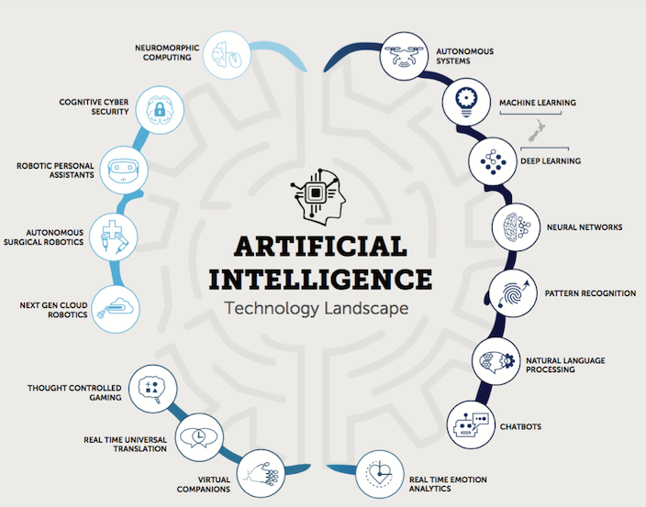
Most Frequently Used Generative AI Technologies
GANs: Generate realistic images & videos via two competing networks.
Transformers: Form the foundation of large language models for text generation (e.g., GPT).
Diffusion Models: Generate high-quality images from noise (e.g., DALL·E).
Variational Autoencoders (VAEs): Compress and generate new content/output like images and audio.
Reinforcement Learning with Human Feedback : Aligns AI output to human feedback, allowing for better outputs.

Slide 4
Generative AI in Practice: Use Case Highlights
Image Generation
Mental health Chatbot
Personal user assistant
Text Summarizer

Slide 5
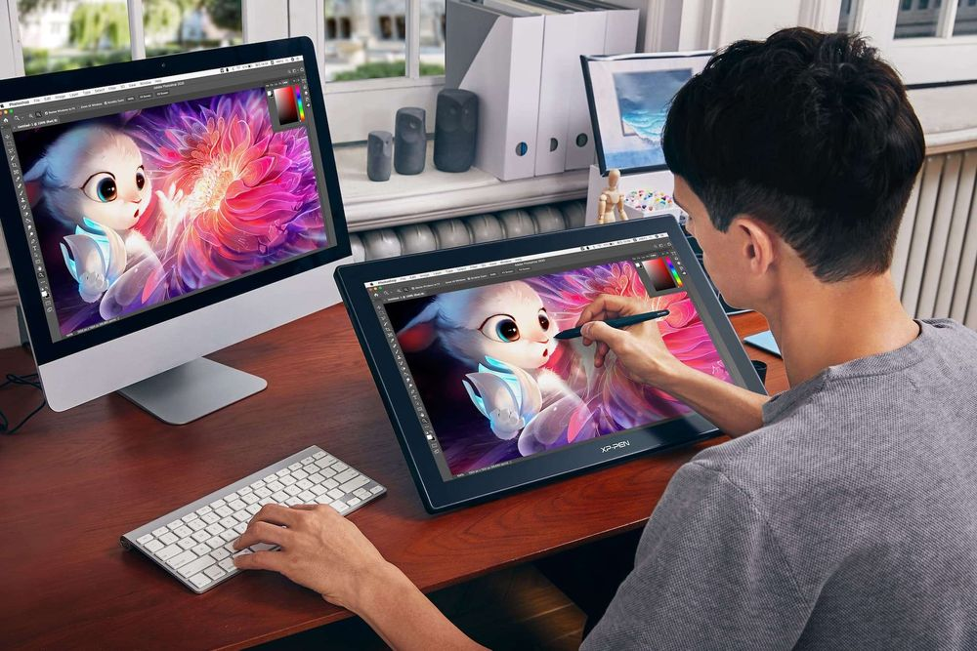
Creation of unique Art and designs

Slide 6

1. AI-Powered Image Generation (From Imagination to Reality)
Use Case: Creating unique, imaginative, or hyper-realistic art using generative models.
Prompt Example: "A cat is going to a library wearing skirts and top, also wearing sunglasses. Make it more realistic — give some people around who are looking at her."
Application:
Can be illustrated in children’s books and visual aids for education
Concept art for video games or movies.
Try-on simulations, product mockups, and campaign visuals.

Slide 7
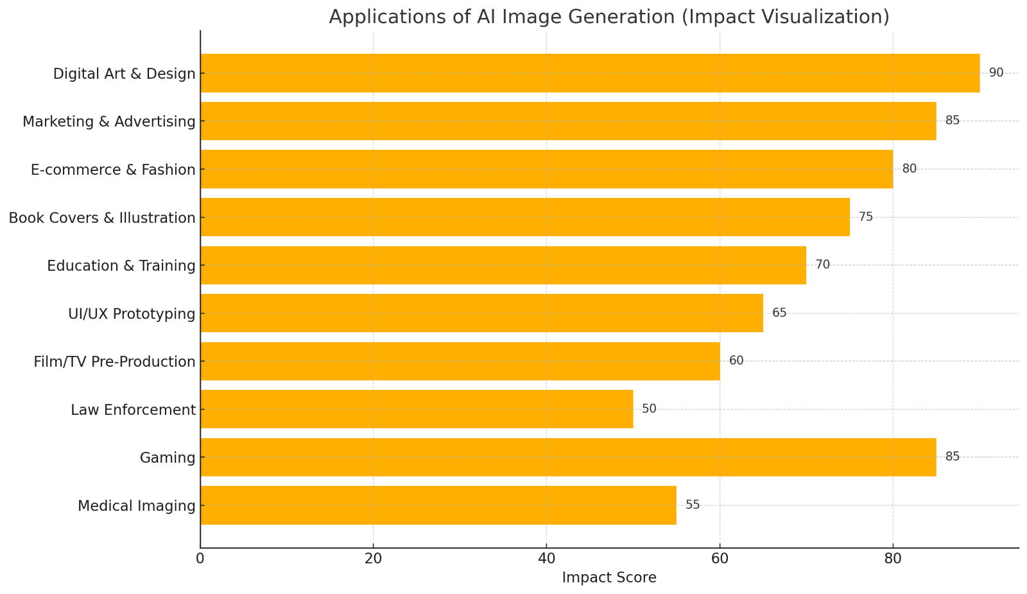
Image Generation
AI image generation works by converting a text prompt into an image using deep learning models trained on huge datasets of images and their descriptions.
Realism improves with more detailed, specific, and context-rich prompts.

Slide 8

Core Tech Behind Image Generation:
Model Type:
Most modern generators like DALL·E, Stable Diffusion, and Midjourney use diffusion models or transformer-based models.
Training Data:
These models are trained on billions of image-caption pairs from the internet.
Latent Space:
Images are represented in a compressed “latent space”
Generation Process:
Prompt is first tokenized (converted to numbers).
A transformer interprets this to understand what features the image
A denoising process starts from random noise and gradually refines it to

Slide 9
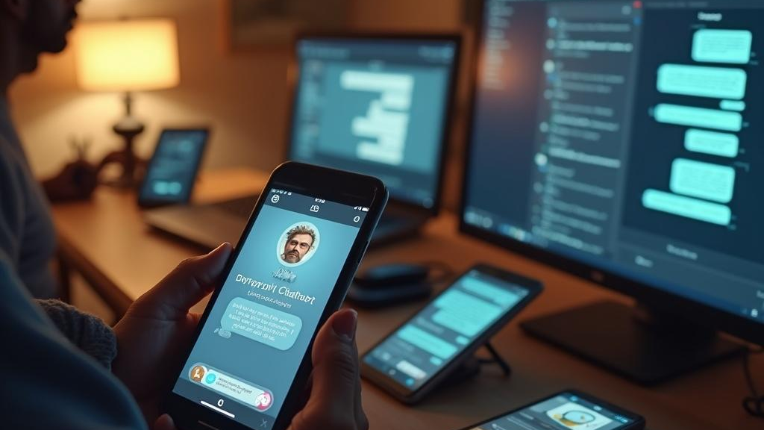
Mental Health Chatbots

Slide 10
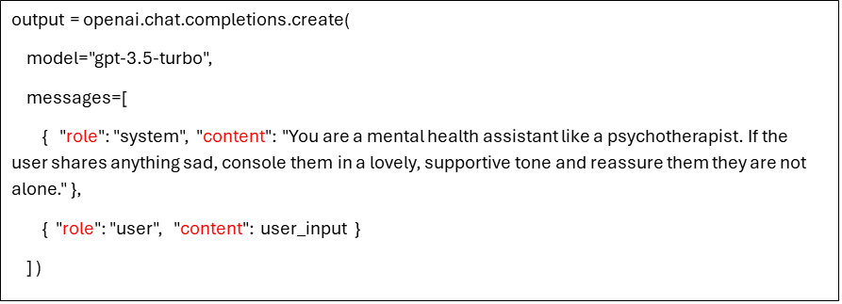
Mental Health Chatbot ( A friend who listens)
Use Case: Providing empathetic, supportive conversations using AI as a digital mental health assistant.
Chatbot: Please write how you are feeling
User: I am feeling very low. please help
Chatbot: I'm so sorry to hear that you're feeling this way. Just know that you are not alone in this. It's okay to feel low sometimes, and it's important to remember that these feelings will pass. Remember that you are strong, resilient, and capable of overcoming any challenges that come your way. You are loved and valued, and I believe in your strength and resilience.

Slide 11
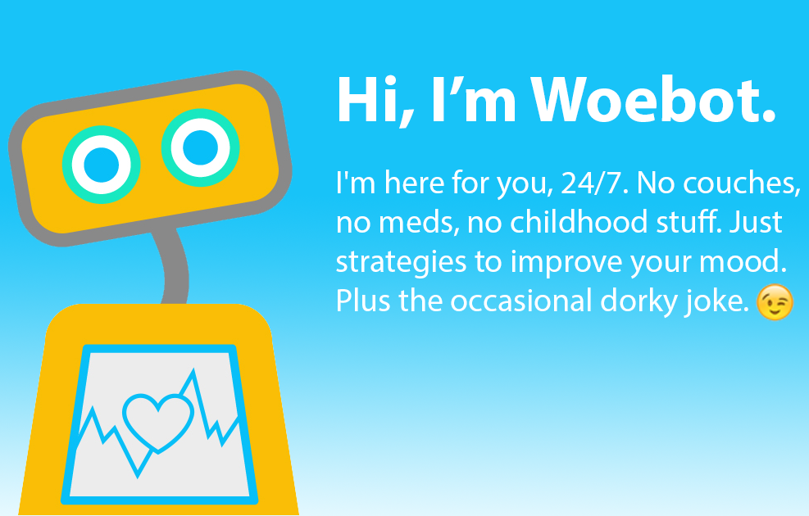
Application:
Can be embedded in mobile apps, web portals, or support widgets.
Ideal for initial emotional support, especially when therapists aren’t available.
Usage:
Creating a mental health chatbot using OpenAI's API involves a few key steps: designing the behavior, structuring the prompt, and handling user input. This is a conversational AI model designed to carry on natural, multi-turn dialogue.
The system prompt and user message are sent to the GPT model.
GPT generates a contextual reply based on its training in psychology, empathy, and conversational tone.
The model does not diagnose, but it mimics supportive behavior.
This Photo by Unknown Author is licensed under CC BY
This Photo by Unknown Author is licensed under CC BY

Slide 12
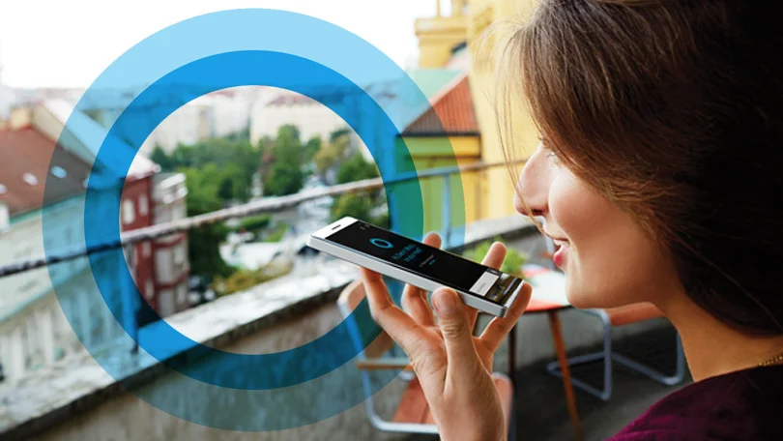
Personalized User Assistant

Slide 13
Personalized User Assistant (Smart Partner)
Component | Purpose
GPT Model | Understands and responds to natural language
Calendar API | Accesses and modifies user's schedule (e.g., Google Calendar API)
Search Integration | Fetches real-time data (e.g., using Google/Bing API or internal engine)
Backend Logic | Connects user requests to services, handles authentication
Use Case: AI assistant to answer specific questions or provide tailored help.
Description:
Creating a Personalized User Assistant using a chatbot integrated with user-specific tools (e.g., calendars, search, reminders)
Combining natural language processing with APIs and services like Google Calendar, Outlook, or a custom database.

Slide 14
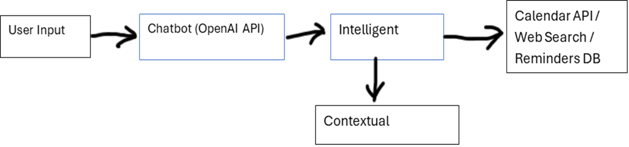
System Design
Output:
User: Do I have anything scheduled for tomorrow?
Assistant: Yes! You have a team sync at 10 AM and a product review meeting at 3 PM. Do you want to set a reminder?
Application:
Acts like a virtual tutor, FAQ bot, or career advisor.
Used in university portals, recruiting tools, or learning platforms.

Slide 15
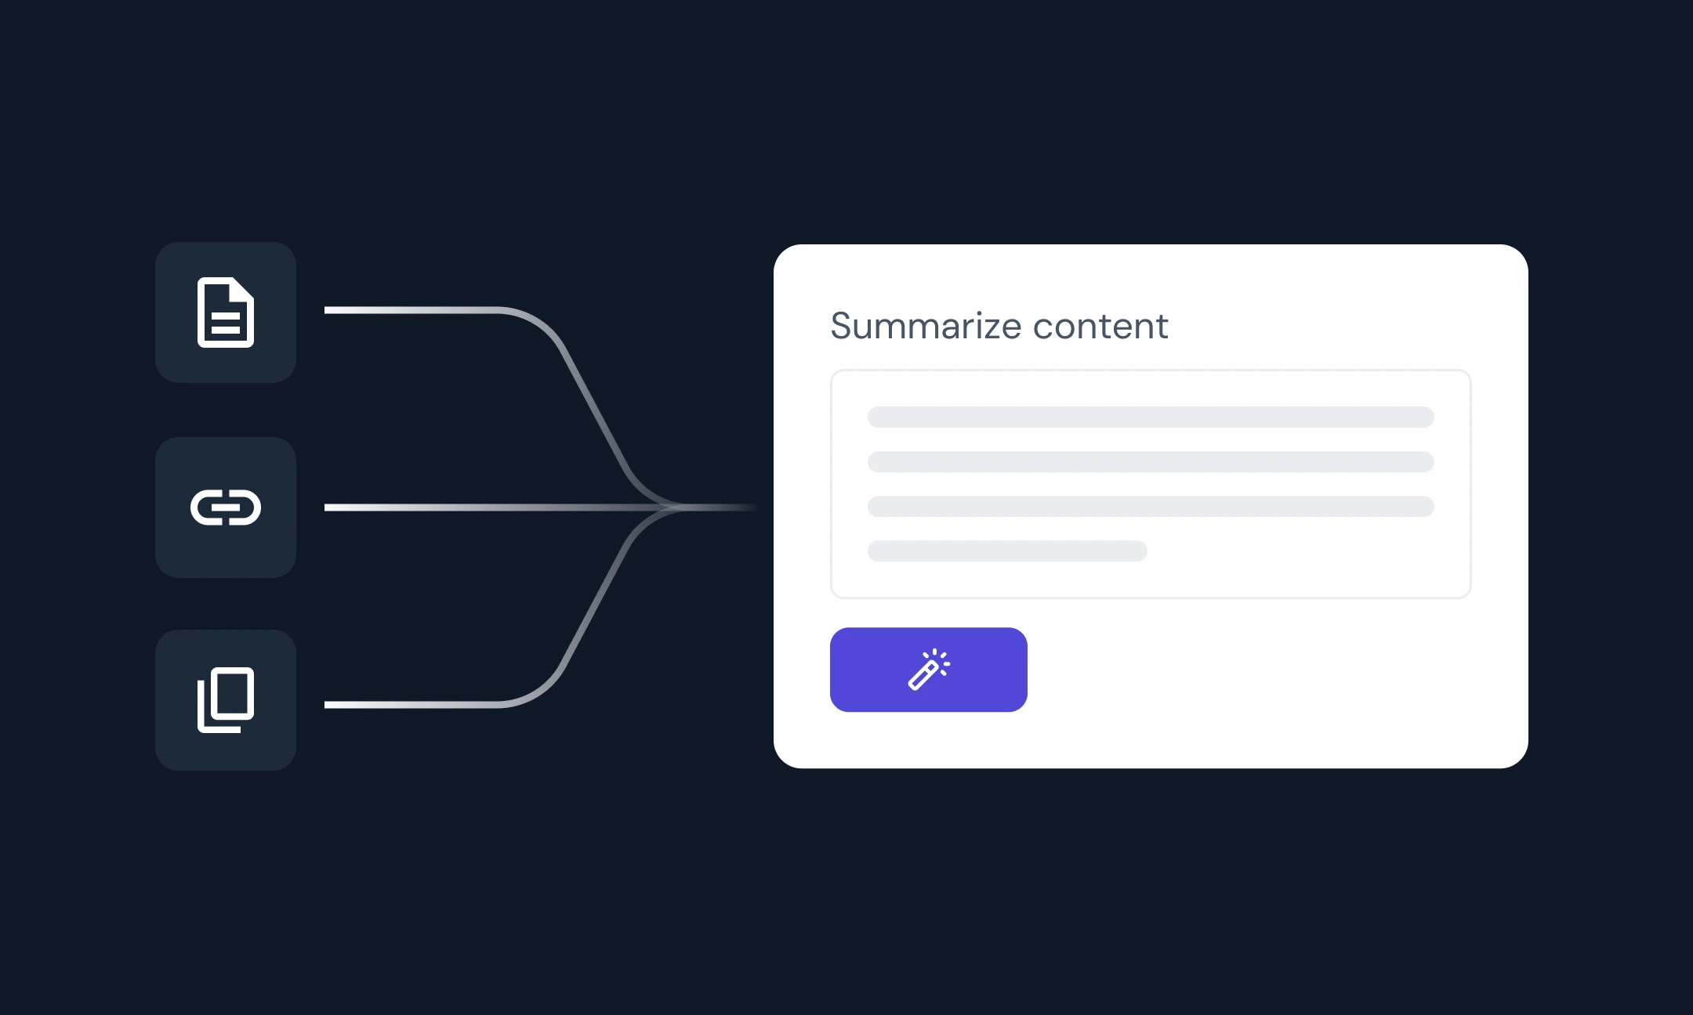
AI Text Summarizer

Slide 16
AI Text Summarizer (Deleting noises)
Use Case: Summarizing long texts, articles, or reports into concise insights.
Description: AI text summarization is the process of using artificial intelligence to automatically generate a concise and coherent version of a longer document.
This technology is crucial in an age of information overload, helping users quickly digest large volumes of content. AI summarizers use natural language processing (NLP) techniques to identify key points and eliminate redundant information.
Types of Text Summarization
Extractive summarization: Selects and compiles important sentences or phrases directly from the source text.
Abstractive Summarization: Generates new sentences that convey the most critical information, using paraphrasing and language generation techniques

Slide 17
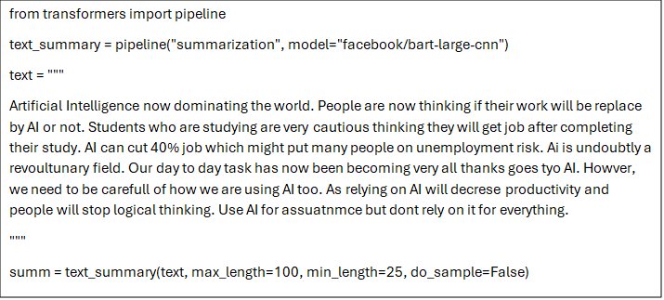
Working Principle
AI text summarizers rely on deep learning models such as transformers (e.g., BART, T5).
These models are trained on massive text corpora and learn to generate concise outputs. They utilize attention mechanisms to identify and weigh the importance of each word or sentence.
Models like Facebook's BART and Google's T5 have set benchmarks in summarization performance.
User Input: A large paragraph of text
Output:
Artificial Intelligence is transforming the world, raising concerns about job displacement and the future of employment, especially among students. While AI greatly enhances daily tasks and is a revolutionary tool, overreliance may reduce human productivity and critical thinking. It should be used as an aid—not a replacement.

Slide 18
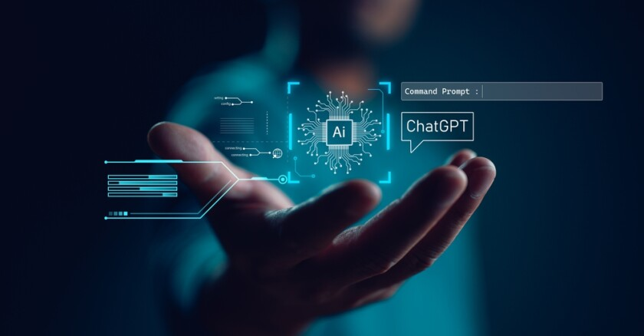
Conclusion
Content creation
Emotional care
Information retrieval
Knowledge summarization
The key to practical use lies in targeted prompts, choosing the right model, and integrating it where users need help the most.

Slide 19
References
Gozalo-Brizuela, R. and Garrido-Merchan, E.C., 2023. ChatGPT is not all you need. A State of the Art Review of large Generative AI models. arXiv preprint arXiv:2301.04655.
Baidoo-Anu, D. and Ansah, L.O., 2023. Education in the era of generative artificial intelligence (AI): Understanding the potential benefits of ChatGPT in promoting teaching and learning. Journal of AI, 7(1), pp.52-62.
Manduchi, L., Pandey, K., Meister, C., Bamler, R., Cotterell, R., Däubener, S., Fellenz, S., Fischer, A., Gärtner, T., Kirchler, M. and Kloft, M., 2024. On the challenges and opportunities in generative ai. arXiv preprint arXiv:2403.00025.
Banh, L. and Strobel, G., 2023. Generative artificial intelligence. Electronic Markets, 33(1), p.63.
Epstein, Z., Hertzmann, A., Investigators of Human Creativity, Akten, M., Farid, H., Fjeld, J., Frank, M.R., Groh, M., Herman, L., Leach, N. and Mahari, R., 2023. Art and the science of generative AI. Science, 380(6650), pp.1110-1111.

Slide 20
Thank You

